Slide 1
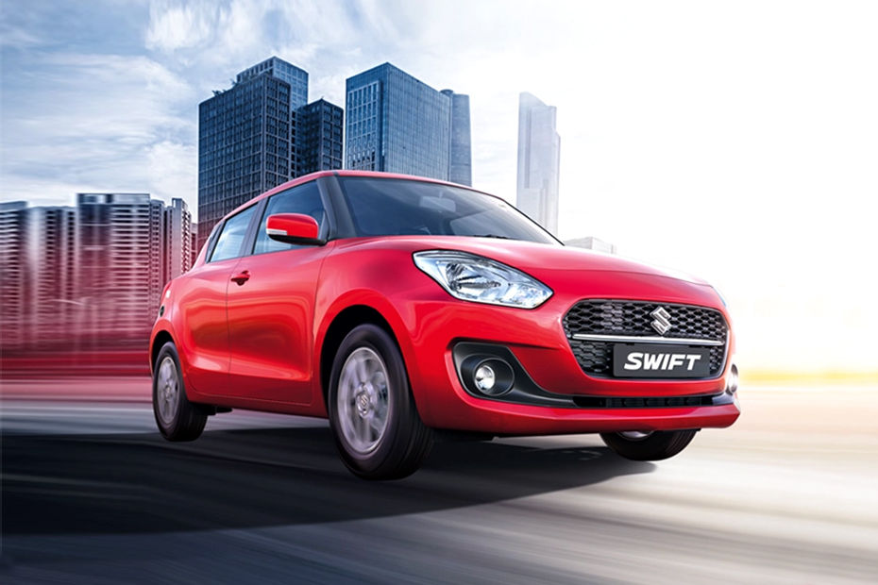
Comprehensive Digital Marketing
Project Work

Slide 2
Part 1: Brand study, Competitor Analysis & Buyer’s/Audience’s Persona
Research Brand Identity: Study the brand's mission, values, vision, and unique selling propositions (USPs).
Mission:The mission of Maruti Suzuki India Ltd is to be the Leader in the Indian Automobile Industry, Creating Customer Delight and Shareholder's Wealth,it is also distinctive being a pride of india.
Vision: The vision of Maruti Suzuki India Ltd is to make every journey an experience and every experience a memory, Maruti Suzuki puts people at the centre of everything it does.
Values:Maruti Suzuki is among the top ten auto brands in the world.the indian car maker was valued at U$S 6,375 million,putting it in ninth place.
USP:Maruti has car models in every segment with a wide price range to choose from,apart from being the most reliable name in Indian automobile market.

Slide 3
Part 1: Brand study, Competitor Analysis & Buyer’s/Audience’s Persona
Analyze Brand Messaging:The brand message of Maruti Suzuki India Ltd is to improve driving eperience and ensure a better future for te coming generations,it make every journey an experience and every experience a memory,it gives more than just a good looking car,Maruti Suzuki ensure that every design element serves a purpose.
Examine the brand's tagline:The tagline of “Maruti Suzuki India Ltd is “Lead the Future of Mobility”

Slide 4
Part 1: Brand study, Competitor Analysis & Buyer’s/Audience’s Persona
Competitor Analysis: Select three competitors operating in the same industry or niche as the chosen brand, examine their USPs and online communication.
Competitor 1: Honda is one of the largest manufacturers of automobiles and motorcycles in the world. It is a Japanese multinational company which operates in North America, Asia and Europe. Honda is also known for the manufacture of aircrafts and power equipment.
Competitor 2: Chevrolet, formally known as Chevrolet Division of General Motors, is an automobile division of American manufacturers General Motors. It was founded in the year of 1911 by Louis Chevrolet and William Durant. It headquarters in Detroit, Michigan, USA with its operation in all parts of the world.
Competitor 3: Ford Motor Company is a US based global leader in the automobile manufacturing industry operating both in commercial vehicles and private cars market. The company was established in 1903 by Henry Ford. After more than 100 years, the firm is one of the largest automobile player in the world.

Slide 5
.
Part 1: Brand study, Competitor Analysis & Buyer’s/Audience’s Persona
Buyer's/Audience's Persona: Clearly define the target audience for the chosen brand. Considerdemographics,psychographics,behaviors,and interests.
Target Audience:‌‌Maruti Suzuki was formerly known as the Maruti Udyog Limited, India, and functioned through a joint endeavor between the government of India and Japan's Suzuki Motor Corporation, signed in 1981.
Maruti Suzuki is widely famous as the largest company in the automobile industry. The company is headquartered in New Delhi and was founded in 1981 by the government of India.
Demographics:

Slide 6
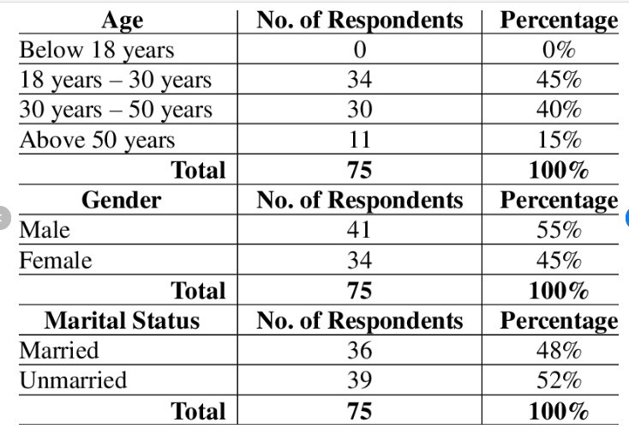

Slide 7
Psychographic:It is basically focuses on middle class people but company does make sports car too. In view of psychological segment, vehicle makers return up with entirely unexpectedvariation of the models of their item. This has been for the most part observed inside the instance of autos, wherever organizations ordinarily returned up with 2 or 3 variations of acomparative model, and it's been found out in terms of professional career investigators that the variation of the medium variation of the model moves of the fore amost Behaviours:CUSTOMER BEHAVIOUR is the study of when, why, how, and where people do or do not buy a product. It blends elements from psychology, sociology, social anthropology and economics. It attempts to understand the buyer decision making process, both individually and in groups. It also tries to assess influences on the customer from groups such as family, friends, reference groups, and society in general. Customer behavior study is based on consumer buying behavior, with the customer playing the three distinct roles of user, payer and buyer. Relationship marketing is an influential asset for customer behavior analysis as it has a keen interest in the re-discovery of the true meaning of marketing through the re-affirmation of the importance of the customer or buyer. Customer Behavior is an information industry term for methodologies, software, and usually internet capabilities that help an enterprise manage customer nature and behavior or customer relationship in an organized way. For example, an enterprise might build a database about its customer that described behavior in sufficient detail so that management , salespeople ,people providing services, and perhaps the customer directly could access information, match customer needs with product plans and offerings. Reminds customer of service requirements, know what other products a customer had purchased, and so forth[9-10]. CB methodologies enable the organization to understand the customer’s needs and behavior better. It introduces reliable process and procedures for interacting with customer.

Slide 8
.
Intrest:
CORPORATE EMPLOYEES:All vehicular needs of a company are taken care of by MSIL.It also provides various offers and benefits to the corporate customers.
FLEETS SALES :MSIL provides vehicles for all sorts of eleets from different industries,meeting their own unique requriments
GOVERNMENT EMPLOYEES:Special benefits to government employees can be availed at any MSIL dealership with valid identification proof

Slide 9
Part 2: SEO & Keyword Research
SEO Audit: Do an SEO audit of the brands website
Keyword Research: Define Research Objectives, Brainstorm Seed Keywords, Utilize Keyword Research Tools (SEMrush or Moz Keyword Explorer),Analyze Competitor Keywords, Long-tail Keyword Exploration (specific, longer phrases) that align with the research objectives and have lower competition but higher conversion potential.
On page Optimization: Meta Tag optimization & content optimization
Reflect on the process of conducting keyword research and the SEO recommendations provided.
Document the challenges faced during the research and analysis phase, as well as the key insights gained from the keyword research process.

Slide 10
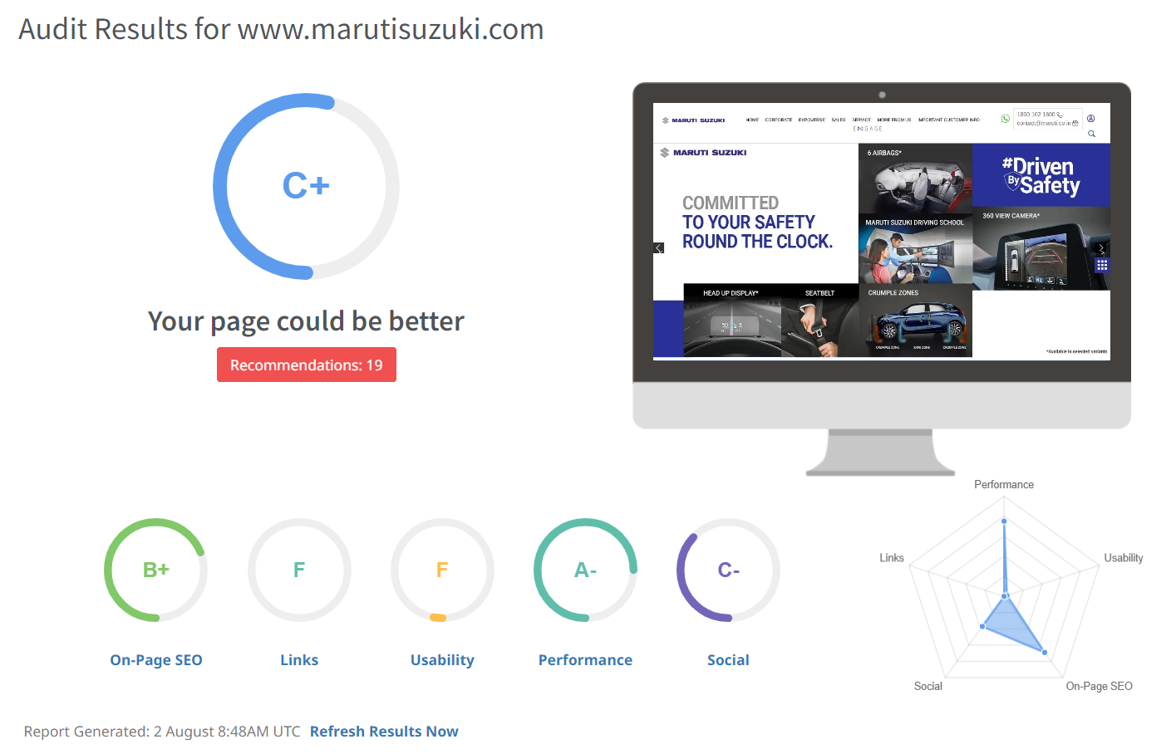
.
PART-2 SEO(Search Engine Optimization)

Slide 11
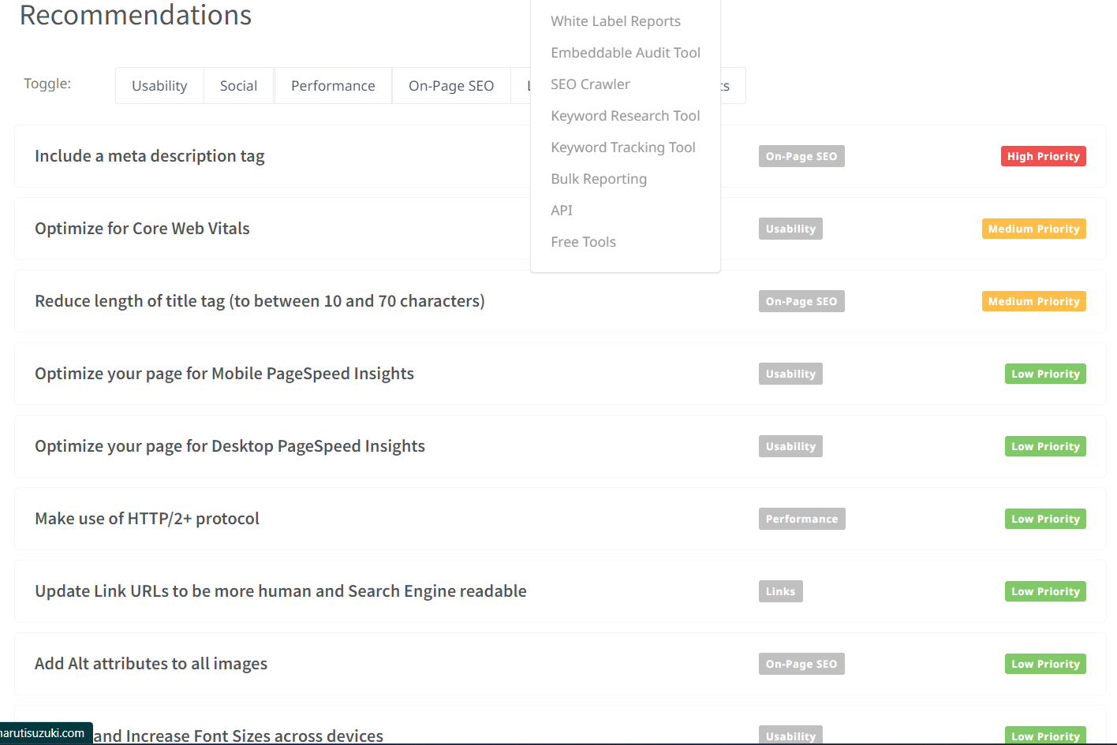
.
SEO(Search Engine Optimization)

Slide 12
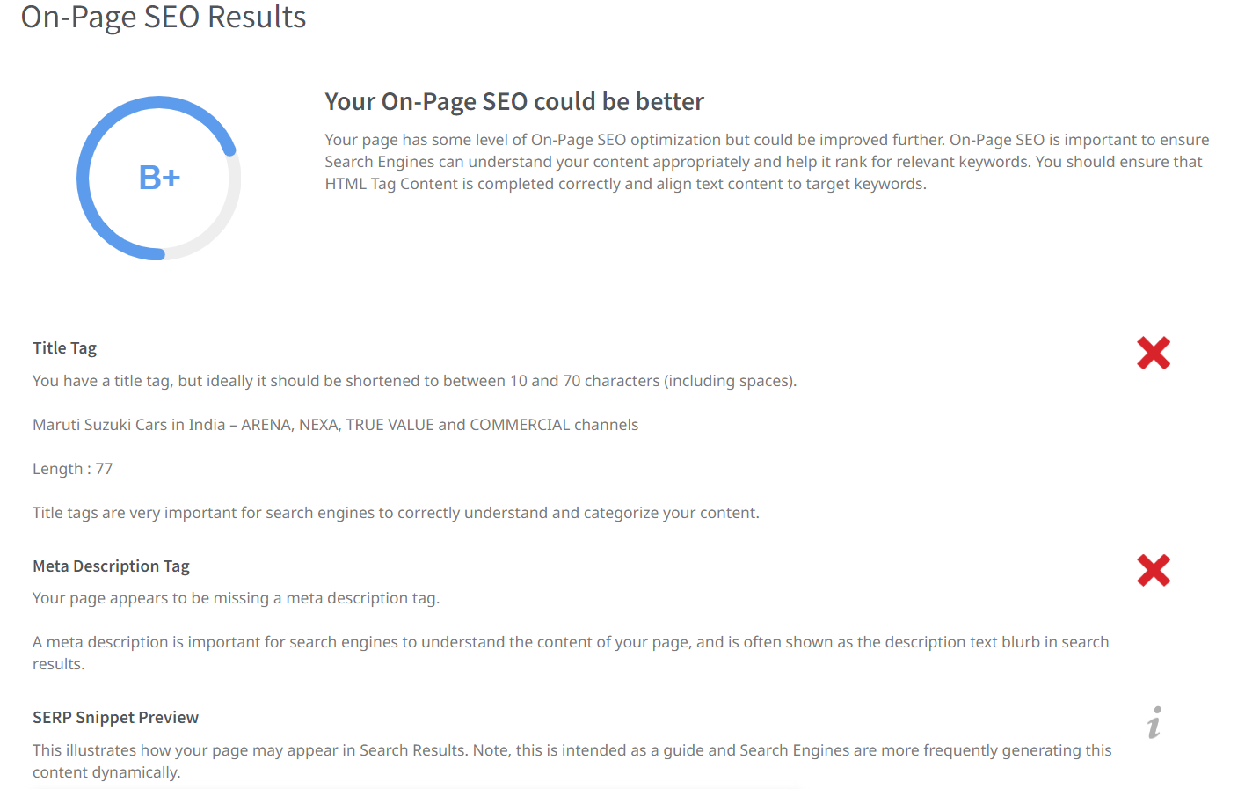
SEO(Search Engine Optimization)
.

Slide 13
.
SEO(Search Engine Optimization)
SEO Audit for Maruti Suzuki India Ltd
Title tags: The title tags are well-optimized, with the brand name and relevant keywords included. The titles are clear and concise, and they accurately reflect the content of the pages. However, the titles could be a bit longer to improve click-through rate (CTR).
Meta descriptions: The meta descriptions are well-optimized, with a clear call to action and a brief overview of the page content. The meta descriptions are accurate and informative, and they are likely to encourage users to click on the links. However, the meta descriptions could be a bit longer to improve CTR.
H1 tags: The H1 tags are well-optimized, with the brand name and relevant keywords included. The H1 tags are clear and concise, and they accurately reflect the content of the pages.
Keyword usage: The keywords are used throughout the website, but there is some room for improvement. For example, the keyword "Maruti Suzuki" could be used more often. The keyword density is not too high, and the keywords are used in a natural way. However, there are some opportunities to use more keywords throughout the website.
.

Slide 14
.
(Search Engine Optimization)
Internal linking: The internal linking is good, with links to relevant pages throughout the website. The links are clear and easy to follow, and they help users navigate the website. However, there is some room for improvement. For example, the homepage could be linked to more often.
Image alt text: The image alt text is well-optimized, with the relevant keywords included. The image alt text is descriptive and informative, and it helps users understand the content of the images.
Social media: Maruti Suzuki is active on social media, with a strong presence on Facebook, Twitter, and Instagram. The social media profiles are linked to on the website, and the social media content is shared on the website. However, there is some room for improvement. For example, the social media profiles could be linked to more prominently on the website.

Slide 15
.
PART:(Keyword Research)
Keyword Research for Maruti Suzuki
Maruti Suzuki is a leading automobile manufacturer in India. The company's website offers a wide range of products and services, including cars, hatchbacks, sedans, SUVs, MPVs, driving school, insurance, finance, parts, accessories, leasing, rewards, exchange, and subscribe.
To optimize the website for search engines, it is important to conduct keyword research. This involves identifying the keywords that people are using to search for Maruti Suzuki's products and services.
Some of the most important keywords for the website include:
Maruti Suzuki
Maruti
Suzuki
cars
automobiles
Indian cars
hatchbacks
sedans
SUVs

Slide 16
.
These are relevant to the products nd services that Maruti Suzuki offers. They are also high-volume keywords, meaning that a lot of people search for them online. This means that there is a good opportunity for Maruti Suzuki to rank high in search results for these keywords.
In addition to the keywords listed above, Maruti Suzuki can also use long-tail keywords and negative keywords to improve its search engine ranking. Long-tail keywords are more specific than short-tail keywords, and they tend to have less competition. This means that it is easier for Maruti Suzuki to rank high for long-tail keywords. For example, some long-tail keywords that Maruti Suzuki could target include:
Best Maruti Suzuki cars
Cheap Maruti Suzuki cars
Maruti Suzuki cars for sale
Maruti Suzuki cars in India
Maruti Suzuki cars with features X, Y, and Z
Negative keywords are words or phrases that you don't want your website to show up for in search results. For example, Maruti Suzuki might want to use the negative keyword "used" to prevent their website from showing up for searches for "used Maruti Suzuki cars."

Slide 17
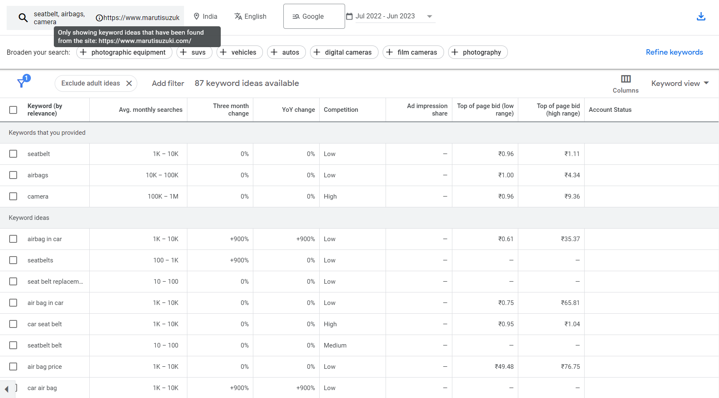

Slide 18
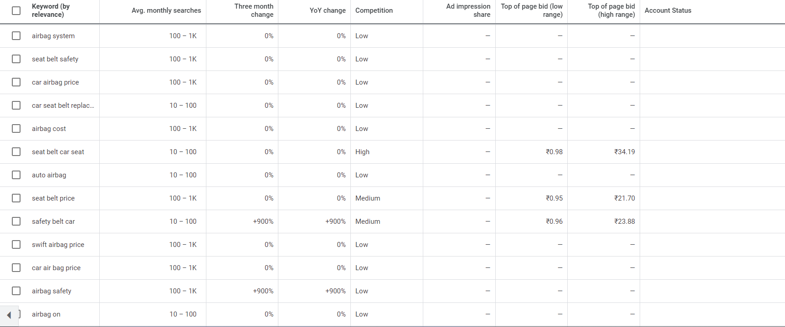
.

Slide 19
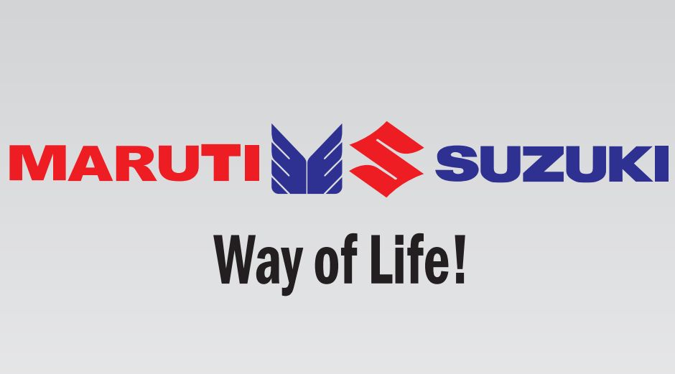
PART 2:(Keyword Research)
On page optimization:Meta Tag optimization & content optimization
Meta Tag Optimization for https://www.marutisuzuki.com/
Title Tag:Maruti Suzuki India Ltd
Description Tag:Experience the all new way to ENGAGE ith all things Maruti Suzuki and more,Driven by safety,Celebrate with ARENA BLACK EDITION,Explore more.
Keywords tag:Maruti Suzuki Arena,Nex,True Value,Commercial.

Slide 20
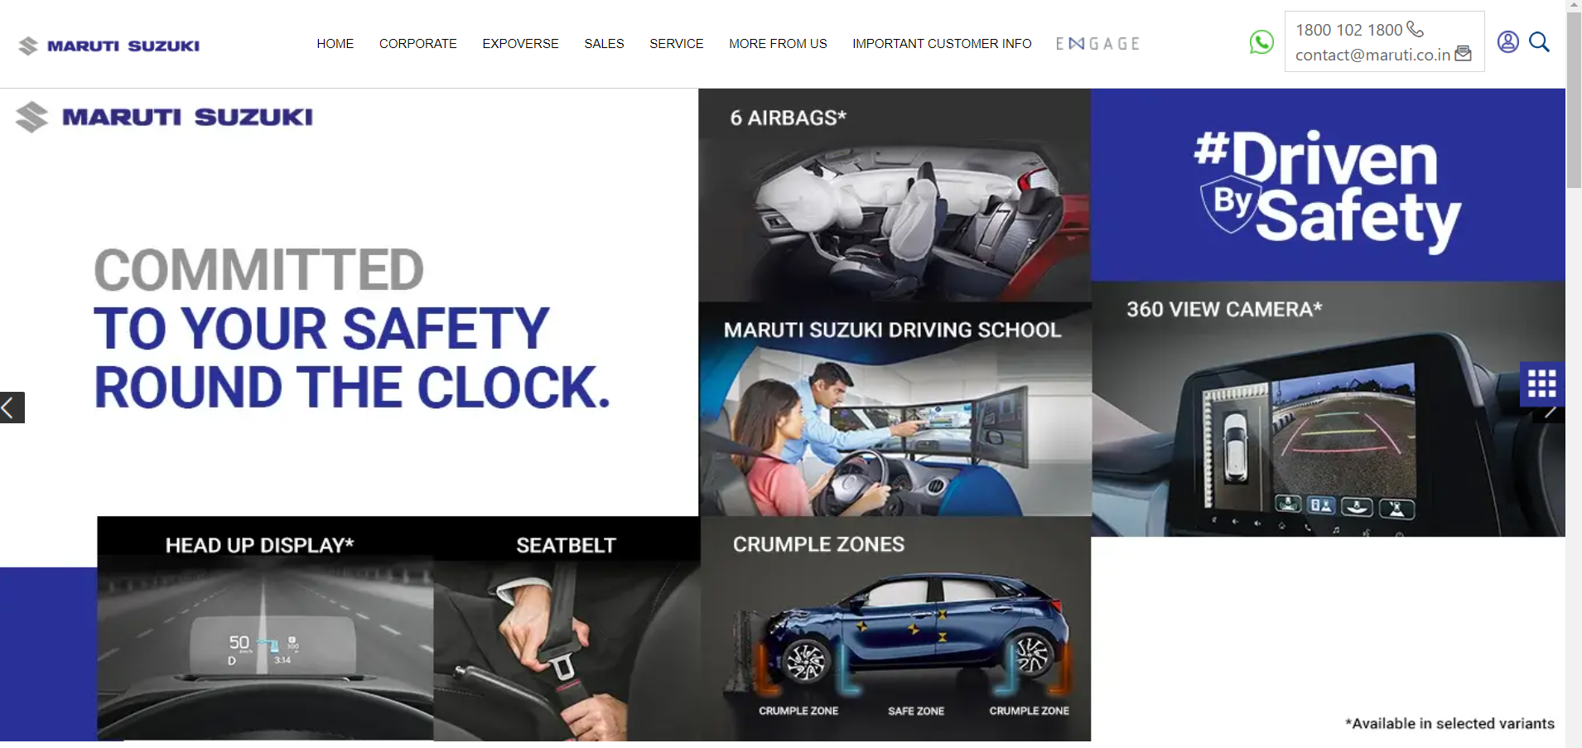
PART 2:(Keyword Research)
Content Optimization: https://www.marutisuzuki.com/ .
Homepage: Homepage shows a logo of Maruti Suzuki India Ltd and its facilities like 6Airbags,360view camera,Headup display,seatbelt etc and on the top of the website it shows the home option, corporate option,expoverse option,sales option,service option,important customer info option etc.

Slide 21
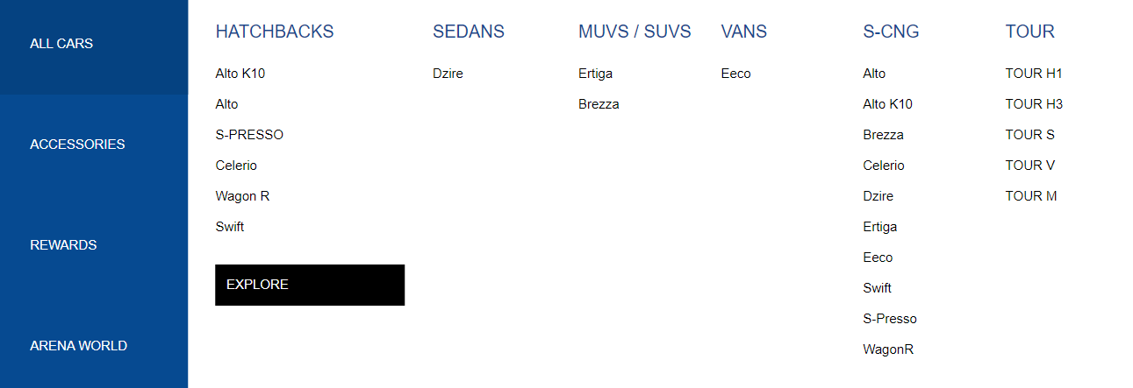
PART 2:(Keyword Research)
Sales page:Sales page shows various cars like Alto k10,S-presso,Celerio,WagonR,Swift dezire,Ertiga,Brezza etc.

Slide 22
Part 3: Content Ideas and Marketing Strategies
Content idea generation&strategy:Create a content calender for the remaining month of july by brainstorming content themes,exploring various formata like blog posts,videos,infographics,podcasts,and interactive quizzes,and scheduling publication dates mainly on facebook & instagram.And include the strategy,aim and the idea behind these posts and story.
Digital Marketing strategy of Maruti Suzuki India Ltd:
Countless micro-moments in digital media are at present, influencing the audience and has a significant impact on the buyer’s journey. Consumers have grown incredibly smart and they would not invest in a car without undertaking research online at every stage of the customer journey.
“A large number of automobile buyers tend to watch online videos before buying a car,” says Tarun Garg, Executive Director, Marketing, Maruti Suzuki. A report stated that video, search and brand or dealer websites remain to be the most substantially influencing factor remodeling the automotive industry.
It is in this circumstance that business leader Maruti Suzuki became determined to take action and shift focus on digital marketing. With online being an indispensable source of resource for research and India hosting over 460 million smartphone users, Maruti recognized it was time to experiment and innovate content designed for the digital world.

Slide 23
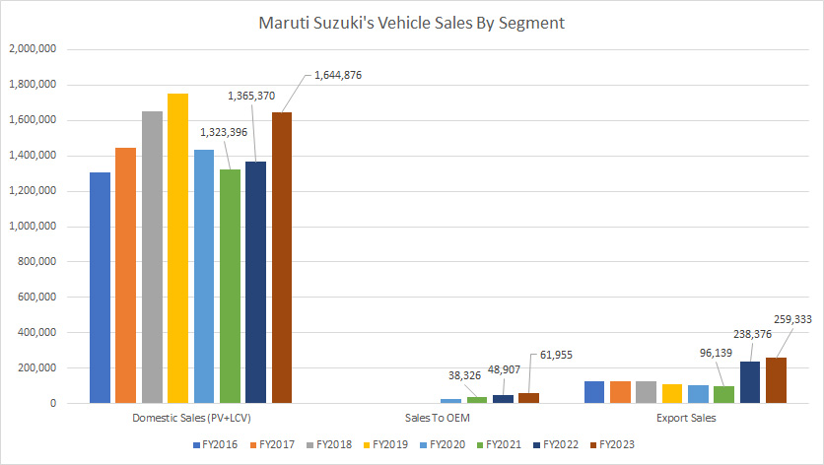
Part 3: Content Ideas and Marketing Strategies
Maruti Suzuki social media marketing overview:Maruti Suzuki is very active in the social media space and has a good fan base across all major platsforms like Twitter,Instagram,and Facebook.It has the highest number of followers on facebook followed by Twitter and Instagram respectively.
Facebook and instagram:

Slide 24
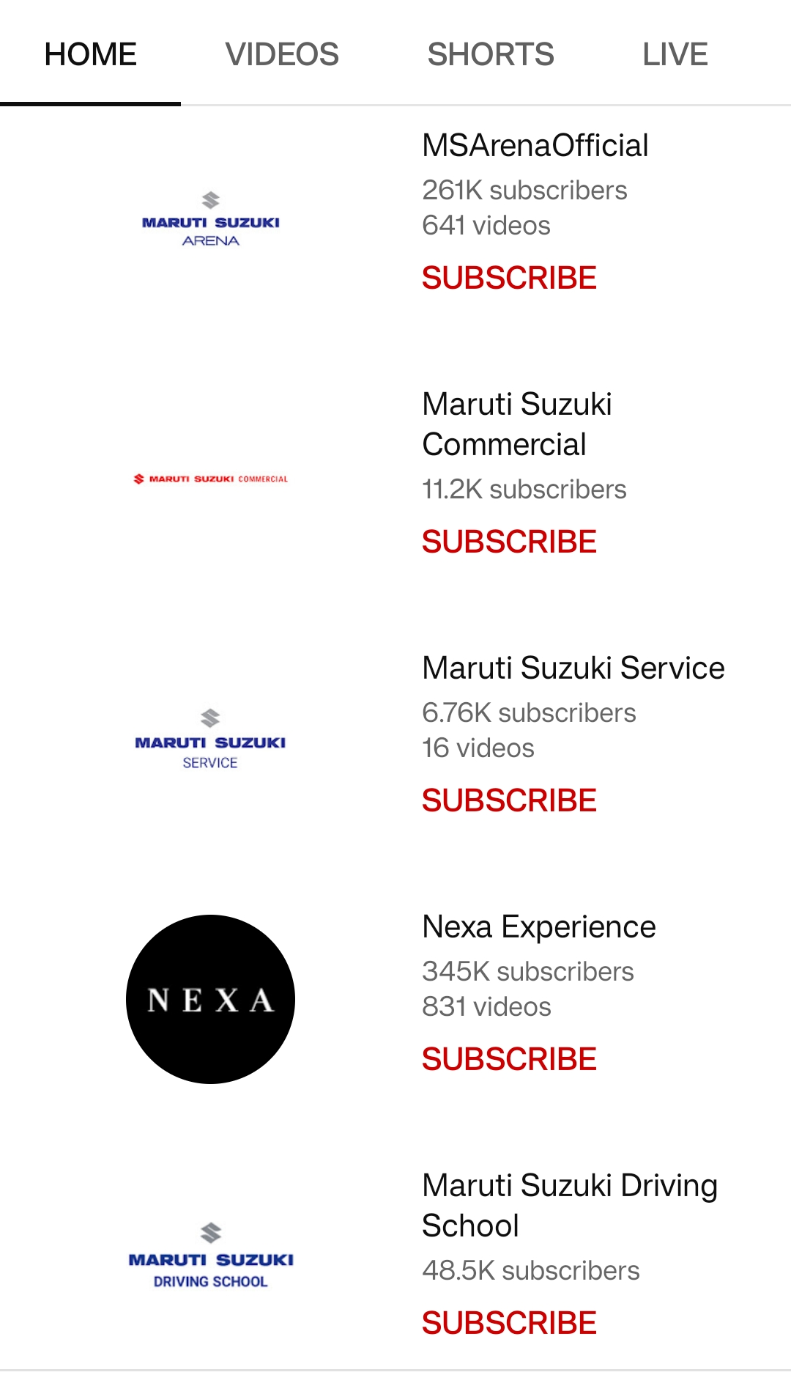
Part 3: Content Ideas and Marketing Strategies
Maruti Suzuki India Ltd’s Brand on YouTube:

Slide 25
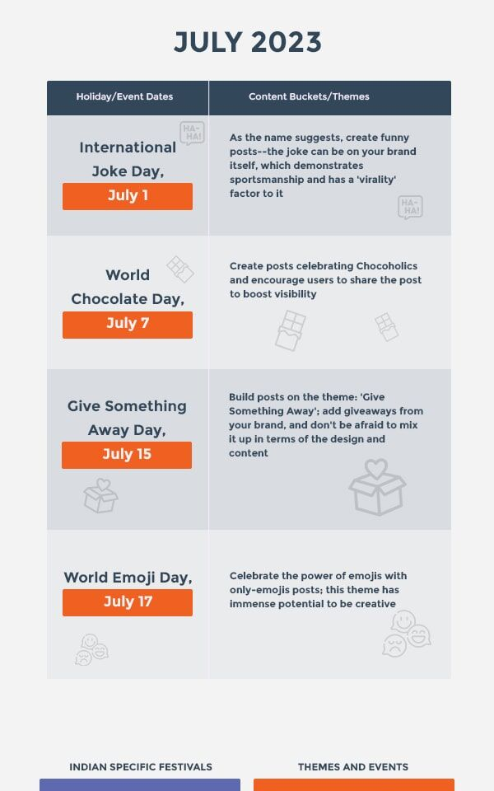
Part 3: Content Ideas and Marketing Strategy

Slide 26
Part 3: Content Ideas and Marketing Strategies
Reflect on the content ideas and marketing strategies process, discussing the challenges encountered and lessons learned.
Content ideas&marketing strategy process:
Marketing strategy of Maruti Suzuki India ltd analyzes the brand with the marketing mx framework which covers the 4Ps(Product,Price,Place,Promotion).These business strategies based on Maruti Suzuki Indi ltd marketing mix,help the brand succeed in the market.
MSIL Product strategy:
Product is anything that can satisfy human needs and wants. The product is a combination oftangible and intangible aspects of the products offered by the manufacturer to the customers.It can be defined as a bundle of satisfactions and dissatisfactions offered by company to thecustomers at a point of time. The product strategy of Maruti is that its focus is on catering theneeds of almost all the segments. Maruti Suzuki offers 16 brands consisting of Maruti 800,MarutiOmni, Maruti Alto, Maruti Versa, Maruti Gypsy, Maruti A Star, Maruti Wagon R,Maruti Zen Estilo, Maruti Swift, Maruti SX4, Maruti Kizashi, Maruti Eeco, Maruti Ertiga,Maruti Grand Vitara and 150 variants spanning across all segments. Thus company creates products that are unique and valued and it is attaining advantage either through differentiationvia new features, improved performance, after sales service or through cost leadership.

Slide 27
Part 3: Content Ideas and Marketing Strategies
MSIL Price & Pricing strategy:
The price is the amount a customer pays for the product. It is fixed after considering variousfactors such as market share, competition, material costs, product identity and the customer's perceived value of the product. The business may increase or decrease the price of product ifother stores have the same product. The price decision is very sensitive and for that specialcare is to be taken to get the competitive edge. There are various factors to determine a priceof a car, such as market condition, cost incurred to build a car, profit by company, dealer profit.The company’s pricing strategies are such that every customer can own a car or upgrade to another one of his or her choice. The company offered a different model at a pricedifference of around 10,000. It follows a price-point-strategy wherein they have productsavailable in almost all possible price points.

Slide 28
Part 3: Content Ideas and Marketing Strategies
MSIL Place & Distribution Strategy:
Distribution strategy of a firm is a plan created by the management of a manufacturing business that specifies how the firm wishes to transfer its products to intermediaries, retailersand end consumers. Maruti Suzuki has two manufacturing facilities in India. Bothmanufacturing facilities have a combined production capacity of 14,50,000 vehicles annually.Maruti has a strong dealer network. Infact it was one of the very first companies in thecountry to understand the importance of after sales service in high involvement products likecars. It has the largest distribution & Service network comprising of over 400 salesshowrooms, over 600 dealer workshops, and 1900 Authorized Service Stations spanningacross over 1190 cities unparalleled in the country. It has 30 Express Service Stations on 30 National Highways across 1,314 cities in India. Most of the service stations are managed onfranchise basis where Maruti trains the local staff. To increase their reach to rural India,

Slide 29
Part 3: Content Ideas and Marketing Strategies
MSIL Promotion & Advertising strategy:
The promotion includes all communications a marketer used in the market for his productsand services to create awareness, to persuade the customers, to buy and retain in future also.For improvement in the position of sales or progress of business this method is used. Themessage is given to target group regarding the features and benefits of the products orservices. Without communication, the features, benefits and schemes would not be known tothe customers and objectives of launching of products or services and increasing sales wouldnot be completed. When communication creates awareness then only the interest would becreated and customers would take the decision for buying. For promotion different methodsof communication can be used. The promotional strategy of Maruti Suzuki is very effective.The company emphasise on road safety and environment friendly products. The company haslaunched road safety mission under which 5,00,000 people will be trained in the next threeyears. This will be done through two channels - Institute of Driving Training and Research(IDTR) and the Maruti Driving Schools spread across the country. Of the 5, 00,000 people to be trained, at least 1,00,000 will be people from underprivileged section of society, who arekeen to take driving as a profession. The company has always promoted the concept of"Reduce, Reuse, Recycle" (3R's). The company has taken help of all the promotional tools like Radio,Television,Road shows,Print media,Workshops and Seminars to promote their cars.

Slide 30
Part 3: Content Ideas and Marketing Strategies
Challenges faced by Maruti Suzuki India Ltd:
The Indian automobile industry is going through a deep structural slowdown and the COVID-19 pandemic has further impacted the sector pushing it back by many years, SIAM President Kenichi Ayukawa said on Wednesday. Speaking at industry body SIAM's 61st Annual Convention, Ayukawa noted that all auto segments like passenger vehicles and two-wheelers have witnessed a drastic drop in growth rates over the last 5-10 years. Even before COVID started, the Indian automobile Industry was facing a deep structural slowdown
Poor build quality has been an ongoing issue with Maruti Suzuki cars. The cars barely score any stars at the Global NCAP testing with the Maruti Vitara Brezza being the only exception in its portfolio that managed to score a four-star rating. All other cars have scored poorly.

Slide 31
Part 3: Content Ideas and Marketing Strategies
Lessons learned from Maruti Suzuki India Ltd:
Companies today increasingly focus on market suppliers and financials while perhaps not investing much in labour relations. On top of that, the labour laws are not fair and not balanced. They tend to favour only one
of the parties — the labour force. Once a manufacturing company employs a permanent staff numbering
more than a 100 people, they become bound by the inflexible labour laws. The employers cannot fire at will.
Before liberalisation, the bulk of the labour force was made up of permanent workers and a small fraction was contract workers. But post-liberalisation, most manufacturers have opted for contract workers to work around unfavourable labour laws. Now, almost 50-60 per cent of the labour force comprises contracted and temporary workers for manufacturers, hired through contracting agencies.
These workers get only those benefits that the agencies think is fit to provide.

Slide 32
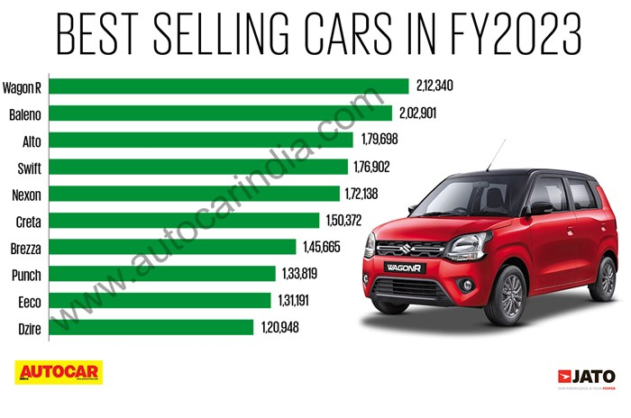
Part 4:Content creation and curation (Post Creation,Designs/video Editing,Ad campaigns over social media and Email ideation and creation)
Post creation:
Select Content Categories: Identify three different content formats relevant to the chosen topic or industry. Research and Brainstorm: Research trending topics, industry news, or audience interests within each category. Brainstorm ideas for social media posts that align with each category. Do note that 1 content format has to be video and additionally 3 stories/status are to be created.
Format 1-(TRENDING NEWS) https://youtu.be/i2ypTwZI8gM

Slide 33
New Delhi: Maruti Suzuki India Limited recorded a noteworthy domestic sales figu . 59,431 units in July 2023, showcasing growth compared to the same period last year.whn the company sold 155,605units.
The overall domestic sales of passengers vehicles (PVs)combined witnessed a substantial increase,reaching 152,126units,as opposed to 142,850 units in the corresponding period last year.However,sales to other original equipment maufacturers (OEMS)experienced a decline,dropping to 4,746units from 9,939 units in the same perod last year.On a positive note,exports grew to 22,199 u nits from 20,311 units.
In the Mini+Compact segment,encompassing models like Mini Alto,S-Presso,Bleno,Celerio,Dzire,Ignis,Swift,Tour S,and WagonR decreased to 76,692 units in july 2023,from 2,816 units in july 2022
.
.
.

Slide 34
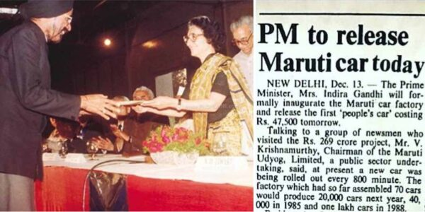
Part 4: Content Creation and Curation (Post creations, Designs/Video Editing, Ad Campaigns over Social Media and Email Ideation and Creation)
Format 2-(ARTICLE)
In 1989,the maruti 1000 introduced and the 970cc, three –box was india’s first contemporary sedan.By 1991,65 percent of the components in 1991,suzuki increased its stake in Maruti to percent,making the company a 50-50 joint venture with the government of india as the other stakeholder .
In 1993,the zen,a993cc engine hatchback was launched was in 1994 the 1,298cc Esteem sedan was introduced.
Maruti produced its 1 millionth vehicle since the commencement of production in 1994. Maruti’s second plant was opened with an annual capacity reaching 200,000 units.Maruti launched a 24-hour emergency on –road vehicle
service.In 1998,the new Maruti 800 was released,being the first change in design since 1986.Zen,D a 1,527 cc diesel hatchback,Maruti’s first diesel vehicle ,and a redesigned owni were introduced.In 1999,the 1.6- litre Maruti baleno three-box sedan and and wagon R were also launched.

Slide 35
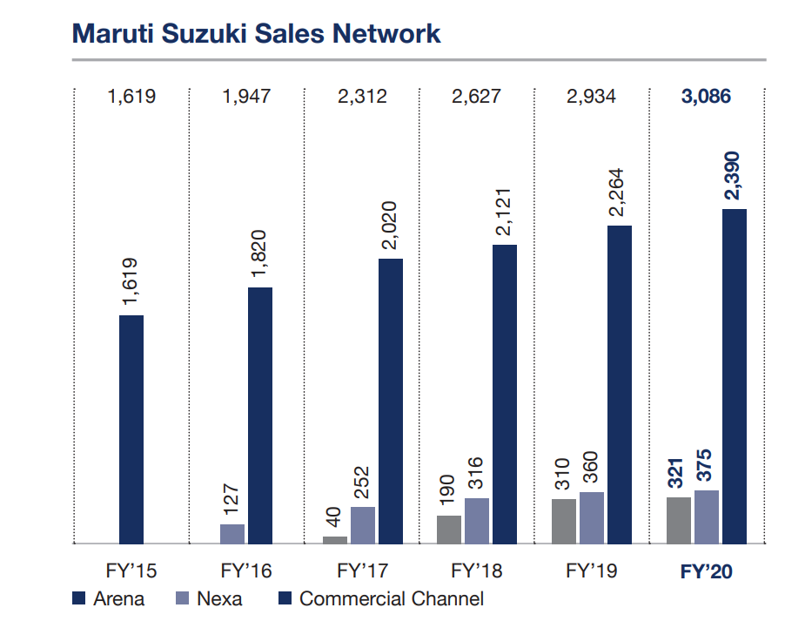
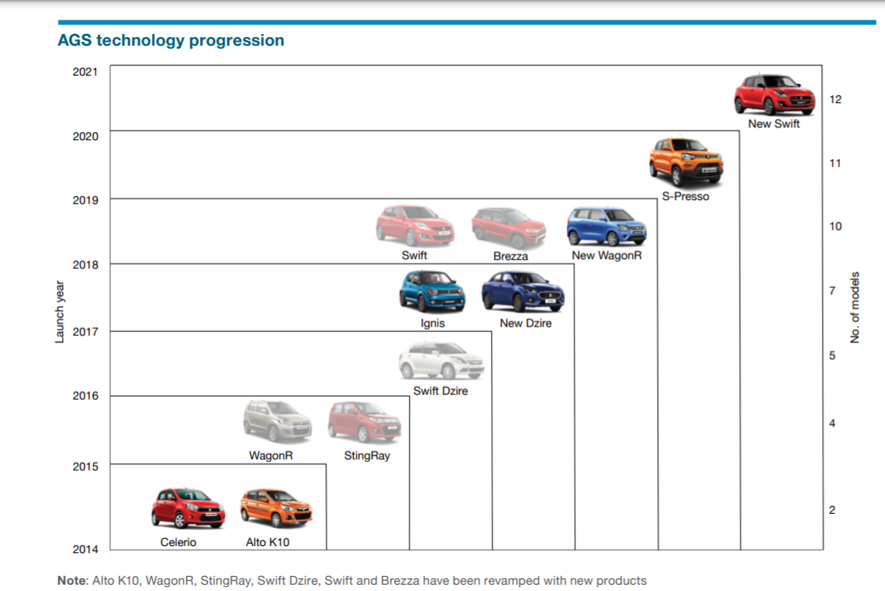
Part 4: Content Creation and Curation (Post creations, Designs/Video Editing, Ad Campaigns over Social Media and Email Ideation and Creation)
Format 3-(PRODUCT PAGE)
Maruti Suzuki's product range extends from entry level small cars like Alto 800, Alto K10 to the luxury sedan Ciaz. Other activities include facilitation of pre-owned car sales fleet management, car financing

Slide 36
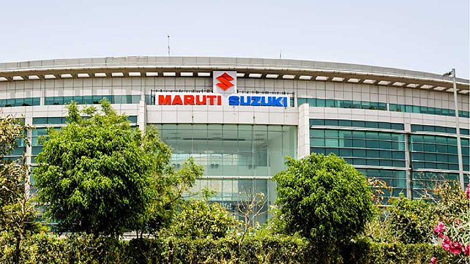
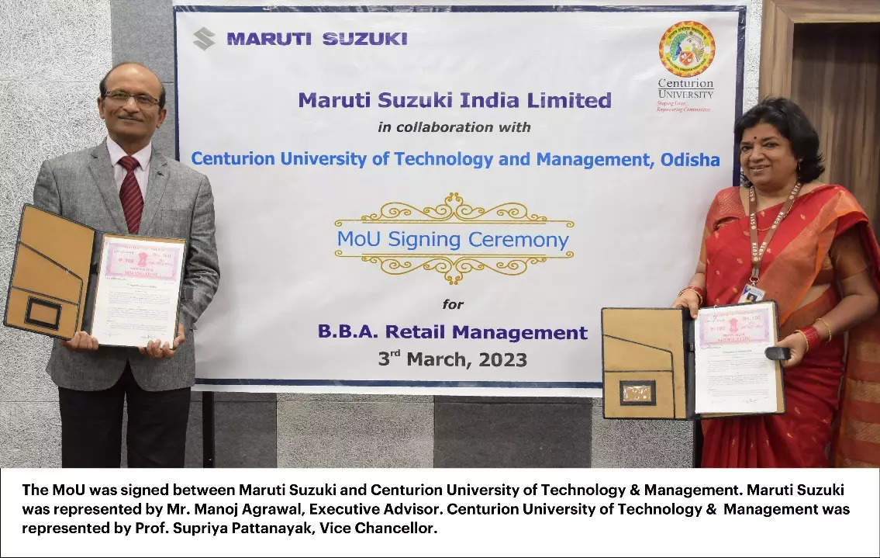
Part 4: Content Creation and Curation (Post creations, Designs/Video Editing, Ad Campaigns over Social Media and Email Ideation and Creation)

Slide 37
Part 4: Content Creation and Curation (Post creations, Designs/Video Editing, Ad Campaigns over Social Media and Email Ideation and Creation)
Instagram Story
Utilize the Stories feature on Instagram for three consecutive days. Share behind-the-scenes glimpses, polls, quizzes, or sneak peeks etc to encourage audience participation. Once uploaded use the story highlight feature on Instagram and save the 3 story with an appropriate name for each.
Analysis:
The company's largest shareholder is the Government of India, with a 51% stake.
Suzuki Motor Corporation of Japan is the second largest shareholder, with a 26% stake.
The remaining 23% of the shares are held by the public.
MSIL employs over 40,000 people.
The company's manufacturing plant in Gurgaon has a capacity of 2.5 million vehicles per year.
The company has a strong focus on safety and has won several awards for its safety features.
MSIL's research and development center in Manesar is one of the largest in India.

Slide 38
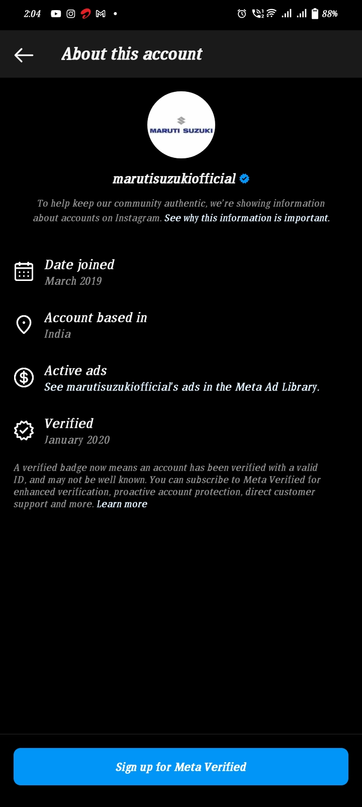
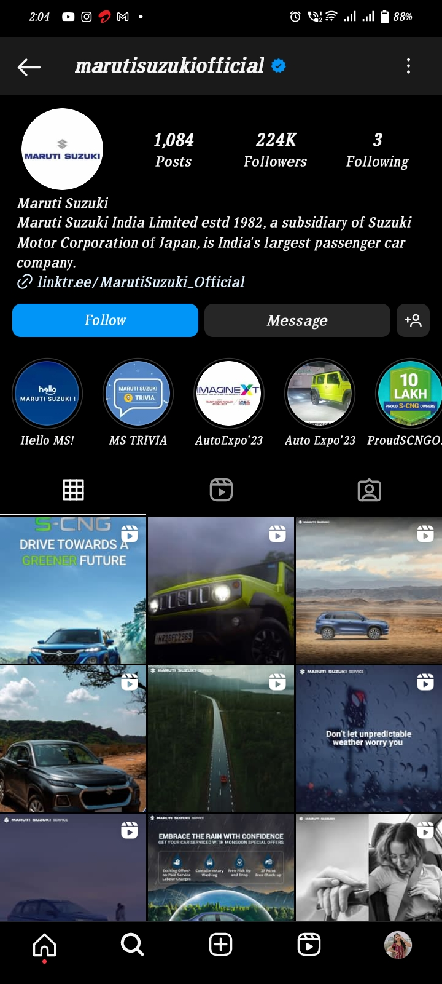
Part 4: Content Creation and Curation (Post creations, Designs/Video Editing, Ad Campaigns over Social Media and Email Ideation and Creation)

Slide 39
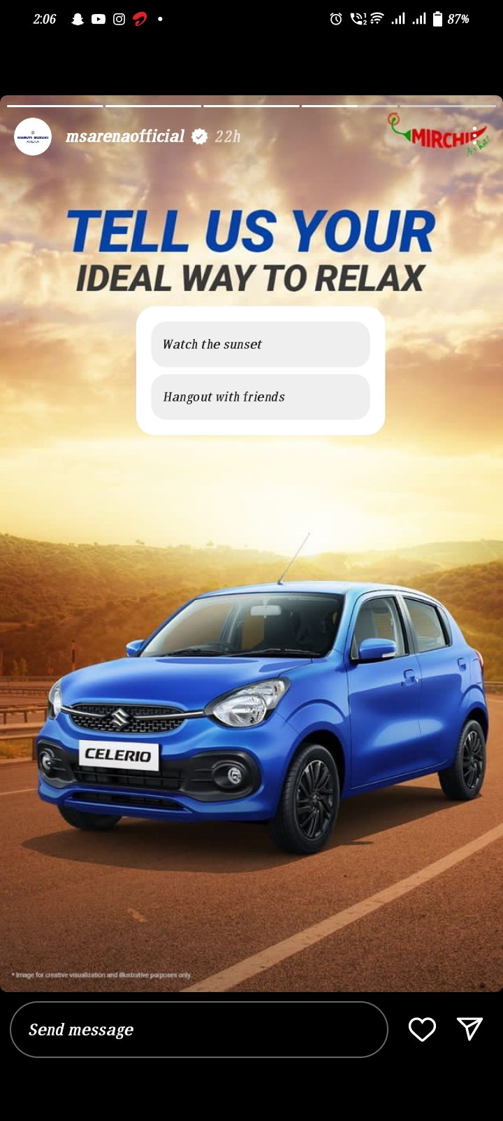
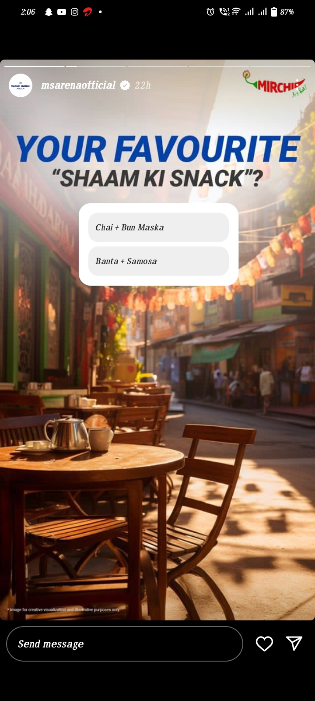
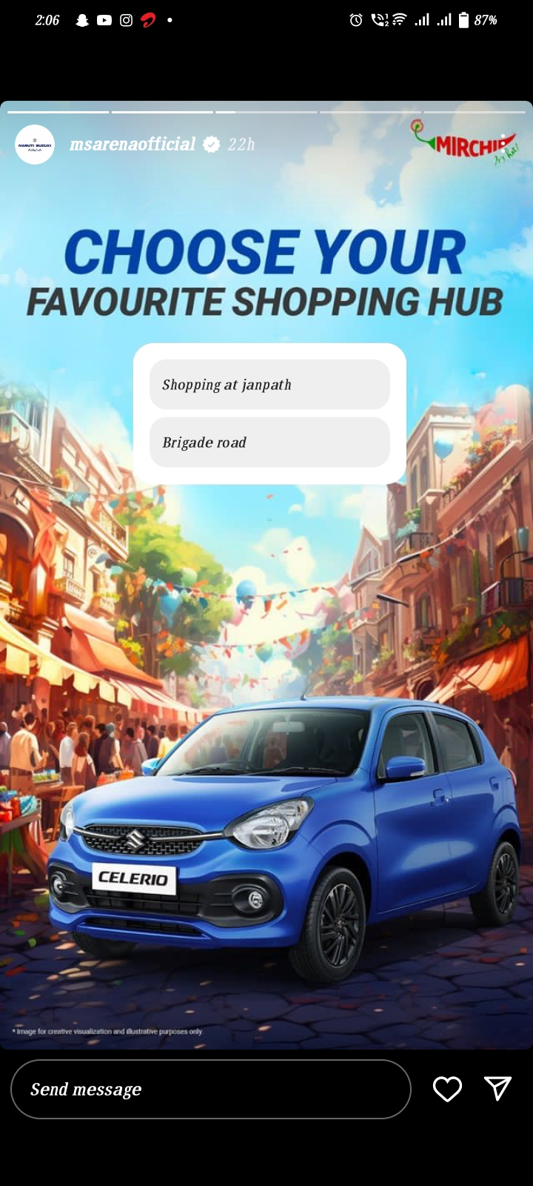
Part 4: Content Creation and Curation (Post creations, Designs/Video Editing, Ad Campaigns over Social Media and Email Ideation and Creation)

Slide 40

Part 4: Content Creation and Curation (Post creations, Designs/Video Editing, Ad Campaigns over Social Media and Email Ideation and Creation)
Designs/Video Editing
Design Tools:Familarization (use Canva for creating visually appealing graphiiics)
Video Cretion:Utilize VN or any video editor of your choice to create videos related to the chosen topic.

Slide 41
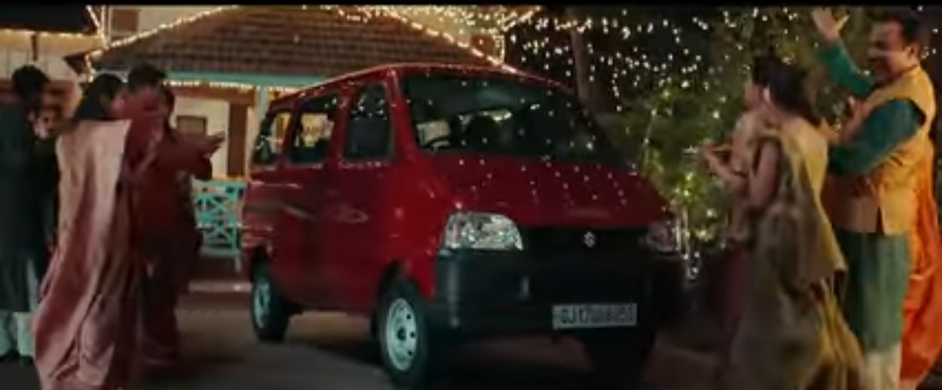
Part 4: Content Creation and Curation (Post creations, Designs/Video Editing, Ad Campaigns over Social Media and Email Ideation and Creation)
Social Media Ad Campaign
Ad campaign over social media
Come up with 3 Ad campaigns each covering one of the mentioned goals;brand awarness,driving website traffic,or generating leads.
https://youtu.be/Im7pyHj-AUs

Slide 42
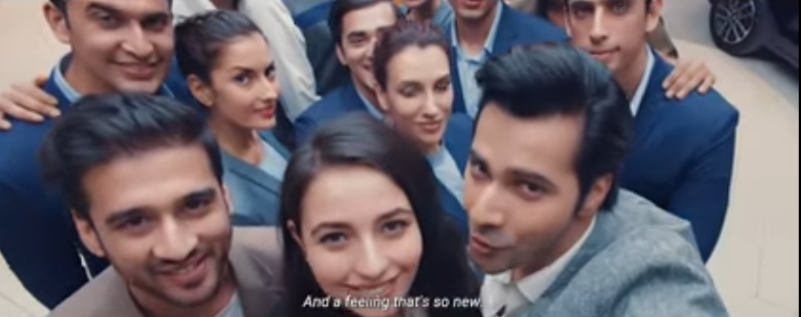
Part 4: Content Creation and Curation (Post creations, Designs/Video Editing, Ad Campaigns over Social Media and Email Ideation and Creation)
Social Media Ad Campaigns
Ad Campaigns over Social Media:
Come up with 3 ad campaigns each covering one of the mentioned goals: brand awareness, driving website traffic, or generating leads
https://youtu.be/YWl63bJvaMk

Slide 43
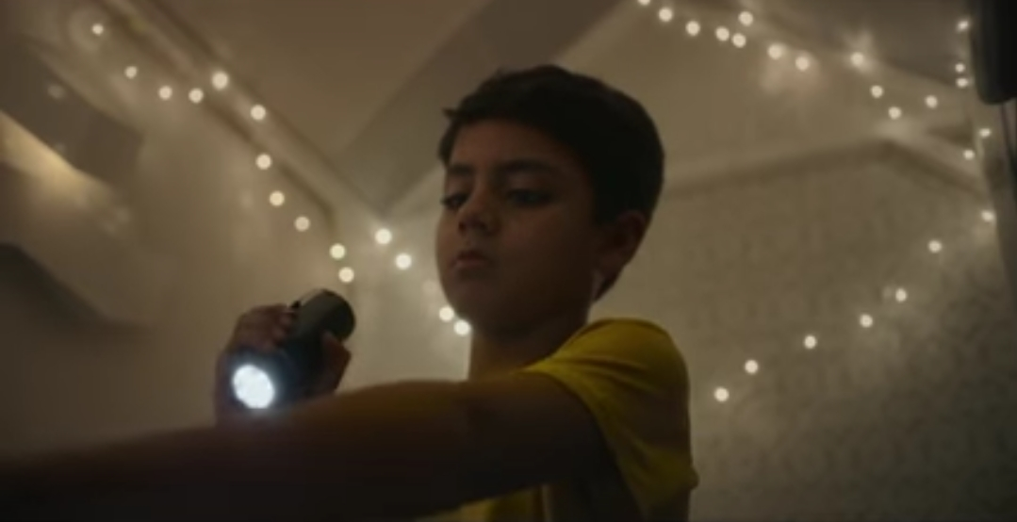
Part 4: Content Creation and Curation (Post creations, Designs/Video Editing, Ad Campaigns over Social Media and Email Ideation and Creation)
Social Media Ad Campaigns
Ad Campaigns over Social Media:
Come up with 3 ad campaigns each covering one of the mentioned goals: brand awareness, driving website traffic, or generating leads
https://youtu.be/aXanM5CHySA

Slide 44
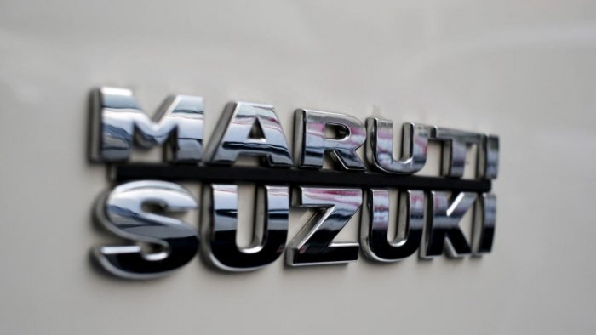
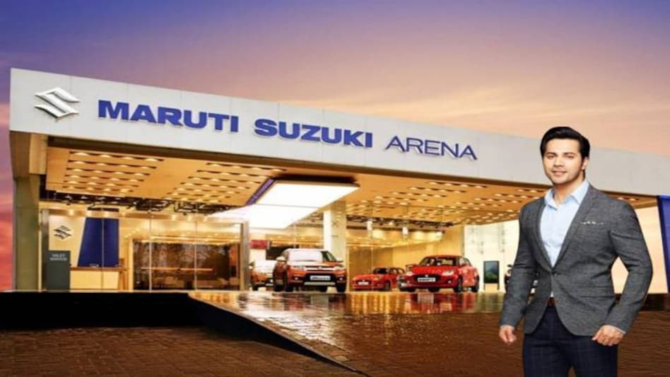
Part 4: Content Creation and Curation (Post creations, Designs/Video Editing, Ad Campaigns over Social Media and Email Ideation and Creation)
Email Ad campaigns contact@maruti.co.in.
Ad campaigns for email marketing
Come up with 2 email id campaigns with the mentioned goals;Brand awarness and generating leads.
(i) Maruti Suzuki India Limited (MSIL) is the largest car manufacturer in India. It is a joint venture between the Government of India and Suzuki Motor Corporation, Japan. MSIL was incorporated in February 1981 as Maruti Udyog Limited, and its name was changed to Maruti Suzuki India Limited in 2007.

Slide 45
Part 4: Content Creation and Curation (Post creations, Designs/Video Editing, Ad Campaigns over Social Media and Email Ideation and Creation)
Brand Awarness:
MSIL has been in the Indian market for over 40 years and has a strong track record of launching successful cars.
MSIL cars are known for their fuel efficiency, reliability, and affordability.
MSIL has a wide network of dealerships and service centers across India.
MSIL invests heavily in marketing and advertising, which helps to keep its brand top-of-mind among consumers.
As a result of its high brand awareness, MSIL is able to command a premium price for its cars. It also has a loyal

Slide 46
Part 4: Content Creation and Curation (Post creations, Designs/Video Editing, Ad Campaigns over Social Media and Email Ideation and Creation)
.
Lead Generation:
Digital marketing: Maruti Suzuki can use digital marketing channels such as search engine optimization (SEO), pay-per-click (PPC) advertising, and social media marketing to reach potential customers.
Content marketing: Maruti Suzuki can create and share high-quality content that is relevant to its target audience. This could include blog posts, infographics, e-books, and videos.
Email marketing: Maruti Suzuki can collect email addresses from potential customers and send them regular emails with updates about the company, its products, and its promotions.
Attending trade shows and events: Maruti Suzuki can attend trade shows and events in the automotive industry to meet potential customers and generate leads
Partnering with other businesses: Maruti Suzuki can partner with other businesses that target the same customer base. This could involve co-marketing campaigns or joint sales promotions.

Slide 47
Part 4: Content Creation and Curation (Post creations, Designs/Video Editing, Ad Campaigns over Social Media and Email Ideation and Creation)
(ii) Brand Awarness:
The company has a strong network of dealerships and service centers across the country. This makes it easy for consumers to purchase and maintain a Maruti Suzuki car.
The company offers a number of after-sales services, such as extended warranties and roadside assistance. This further enhances the customer experience and helps to build brand loyalty.
The company is known for its commitment to social responsibility. Maruti Suzuki has been involved in a number of initiatives to improve the lives of people in India, such as the construction of schools and hospitals. This has helped to create a positive image for the company and has made it more popular with consumers.

Slide 48
Part 4: Content Creation and Curation (Post creations, Designs/Video Editing, Ad Campaigns over Social Media and Email Ideation and Creation)
Lead Generation:
Personalize the lead generation process. This means using the customer's name, location, and other information to create a more relevant and engaging experience.
Make it easy for customers to submit their information. The lead generation form should be clear and concise, and it should be easy to find on the website.
Follow up with leads promptly. This shows that the company is interested in their business and that they are a valued customer.
Use lead scoring to prioritize leads. This means assigning a score to each lead based on their likelihood of converting into a sale. This helps the company focus its resources on the most promising leads.

Slide 49
Part 4: Content Creation and Curation (Post creations, Designs/Video Editing, Ad Campaigns over Social Media and Email Ideation and Creation)
Reflect on the content creation and curation process,discussing the challenges faced and lessons learned.
Challenges and lessons learned in content creation and curation at Maruti Suzuki India Ltd:
Competition - Maruti Suzuki faces stiff competition from other car manufacturers, such as Hyundai, Tata, and Mahindra. These companies are constantly innovating and introducing new models, which makes it difficult for Maruti Suzuki to maintain its market share.
Changing customer preferences - The Indian car market is changing rapidly, and customers are becoming more demanding. They are looking for cars that are fuel-efficient, feature-rich, and stylish. Maruti Suzuki needs to adapt its products to meet these changing preferences.
Government regulations - The Indian government is constantly introducing new regulations for the automotive industry. These regulations can make it difficult for Maruti Suzuki to manufacture and sell its cars.
Economic slowdown - The Indian economy is currently facing a slowdown, which is impacting the demand for cars. This is a challenge for Maruti Suzuki, as it will need to find ways to boost sales in a tough market.

Slide 50
Part 4: Content Creation and Curation (Post creations, Designs/Video Editing, Ad Campaigns over Social Media and Email Ideation and Creation)
Reflect on the content creation and curation process,discussing the challenges faced and lessons learned.
Challenges and lessons learned in content creation and curation at Maruti Suzuki India Ltd:
Despite these challenges, Maruti Suzuki is well-positioned to continue to be the leading car manufacturer in India. The company has a strong brand, a wide range of products, and a vast network of dealerships. If Maruti Suzuki can continue to innovate and meet the changing needs of customers, it will be well-placed to weather the challenges ahead.
Here are some additional challenges that Maruti Suzuki may face in the future:
The rise of electric vehicles - Electric vehicles are becoming increasingly popular, and this could pose a threat to Maruti Suzuki's dominance in the Indian car market. The company will need to invest in electric vehicle technology if it wants to stay ahead of the curve.
The growth of online sales - Online sales are growing rapidly in India, and this could also impact Maruti Suzuki's business. The company will need to adapt its sales strategy to meet the needs of online shoppers.

Slide 51
Part 4: Content Creation and Curation (Post creations, Designs/Video Editing, Ad Campaigns over Social Media and Email Ideation and Creation)
Reflect on the content creation and curation process,discussing the challenges faced and lessons learned.
Challenges and lessons learned in content creation and curation at Maruti Suzuki India Ltd:
The emergence of new market entrants - New car manufacturers are entering the Indian market, and this could pose a challenge to Maruti Suzuki's market share. The company will need to stay ahead of the competition by offering innovative products and services.
Maruti Suzuki is a well-established company with a strong track record, but it will need to address these challenges if it wants to continue to be successful in the future.

Slide 52
Part 4: Content Creation and Curation (Post creations, Designs/Video Editing, Ad Campaigns over Social Media and Email Ideation and Creation)
Lessons Learned:
Maruti Suzuki India Limited has been in business for over 40 years, and it has learned a lot during that time. Here are some of the lessons that the company has learned:
The importance of brand building - Maruti Suzuki has built a strong brand over the years, and this has been a key factor in its success. The company has done this by consistently delivering high-quality products and services, and by investing in marketing and advertising.
The importance of customer satisfaction - Maruti Suzuki knows that customer satisfaction is essential for its success. The company has a strong focus on customer service, and it strives to provide a positive experience for its customers.
The importance of innovation - Maruti Suzuki is constantly innovating, and this has helped the company to stay ahead of the competition. The company has introduced a number of new technologies and features, and it is always looking for ways to improve its products.
These are just some of the lessons that Maruti Suzuki India Limited has learned over the years. The company is constantly learning and evolving, and it is well-positioned to continue to be successful in the future.

Slide 53
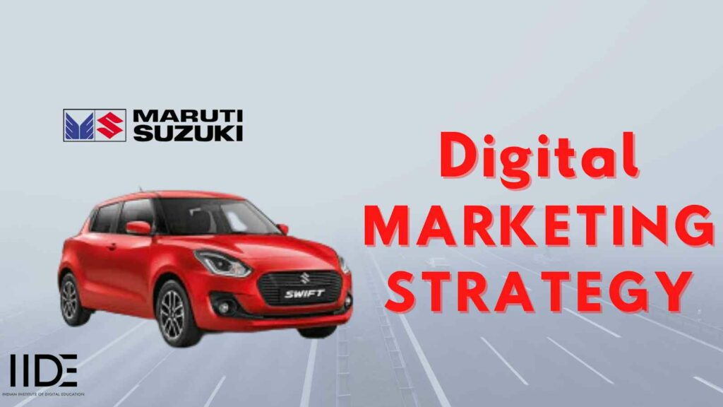
Part 4: Content Creation and Curation (Post creations, Designs/Video Editing, Ad Campaigns over Social Media and Email Ideation and Creation)
Ad Campaigns for email marketing:

Slide 54
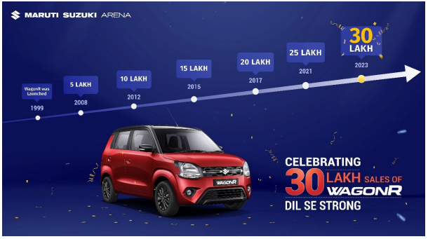
Email Ad Campaign 1 - Brand Awareness
(insert emailer image
contact@maruti.co.in.
.

